Slide 1
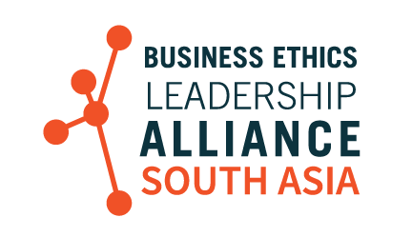
India’s Business Case for Compliance
Business Ethics Leadership Alliance South Asia
Membership Resource
April 2019
Notes:
1

Slide 2
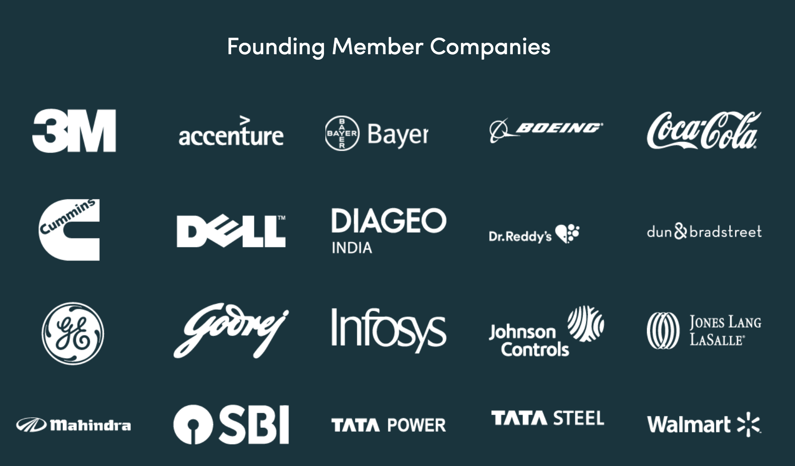
About the Business Ethics Leadership Alliance
(BELA) South Asia Chapter
Setting the Gold Standard for Business Ethics Across South Asia
Together with the Confederation of Indian Industry (CII), the largest industry association in India, whose mission is to create an environment conducive for the growth of industry in the country, BELA South Asia includes a community of 20 select multinational companies who will serve as Founding Members of this exclusive initiative.
Founding member companies are tasked with shaping the strategic and tactical direction of the chapter while playing a leadership role in inspiring best practices in ethics, integrity, and anti-corruption efforts across India and South Asia.
Notes:
2

Slide 3
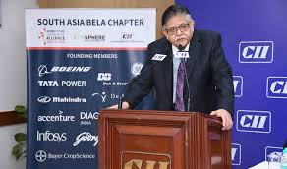
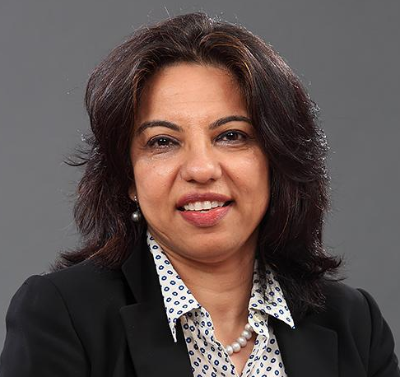
About the Business Ethics Leadership Alliance
(BELA) South Asia Chapter
Setting the Gold Standard for Business Ethics Across South Asia
“This partnership with Ethisphere will help in bringing to India industry best practices and experiences from around the world.”
Sumit Mazumder, past President of CII, and Chairman, CII National Committee on Integrity and Transparency
“With a roster of prestigious multinational companies on board for the BELA South Asia Chapter, we are confident that we can coordinate efforts to set a gold standard for ethics and principled business practices.”
Tejal Patil, General Counsel, GE South Asia
“We are proud to be a founding member of Ethisphere’s BELA South Asia Chapter in India. This platform will act as an interactive resource where experts can counsel businesses in the region with global best practices in corporate ethics.”
Inderpreet Sawhney, General Counsel and Chief Compliance Officer, Infosys
Notes:
3

Slide 4
Dear BELA South Asia Community Member,
According to the 2019 Doing Business Report released by the World Bank, India is now ranked 77th of 190 countries assessed by the World Bank for ease of doing business. India's leap of 23 ranks is significant, considering the country’s performance also improved by 30 places last year, a rare feat for any large and diverse country the size of India. But as each of you know, over the past two years we have worked hard to address this perception through our efforts with our BELA SA Chapter. We are developing best practices that can be employed and sharing strategies and tactics for creating a more ethical environment. We also know that for our program to have maximum impact, we need to communicate and share the work we are doing.
To that end, this presentation was developed to help guide you in your conversations with internal and external stakeholders about the importance of embracing compliance as a competitive business advantage. BELA members report using this business case deck in a myriad of ways, including:
Briefing regional compliance liaisons on the economic, geopolitical, and social conditions that impact today’s ethical leaders
Illustrating to business unit leaders of the costs and consequences of compliance failures
Motivating middle management by giving the business case of why integrity and compliance are so important
Convincing executive leadership through data-driven evidence of ways to further build your program and engage stakeholders
Whether using it off the shelf, customizing the slides with your own branding, or embedding relevant content into your existing leadership or board presentations, we welcome you to use these slides as you see fit.
Your continued involvement within the BELA community allows us to develop these types of resources and actionable research to empower you in your efforts. We invite you to share your thoughts about what to include in future revisions of this presentation with us. As India’s business ethics environment continues to mature, it stands to reason that the world will take notice, making India a most attractive place to conduct international business and trade. We would love to be a big part of that continued evolution, where data will show that India is a role model for other nations to follow.
Best wishes,
Aarti Maharaj
Managing Director, BELA South Asia
Aarti.maharaj@ethisphere.com
Kevin McCormack
Executive Director, BELA Kevin.mccormack@ethisphere.com
Notes:
4

Slide 5
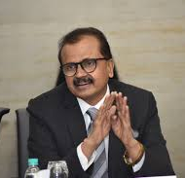
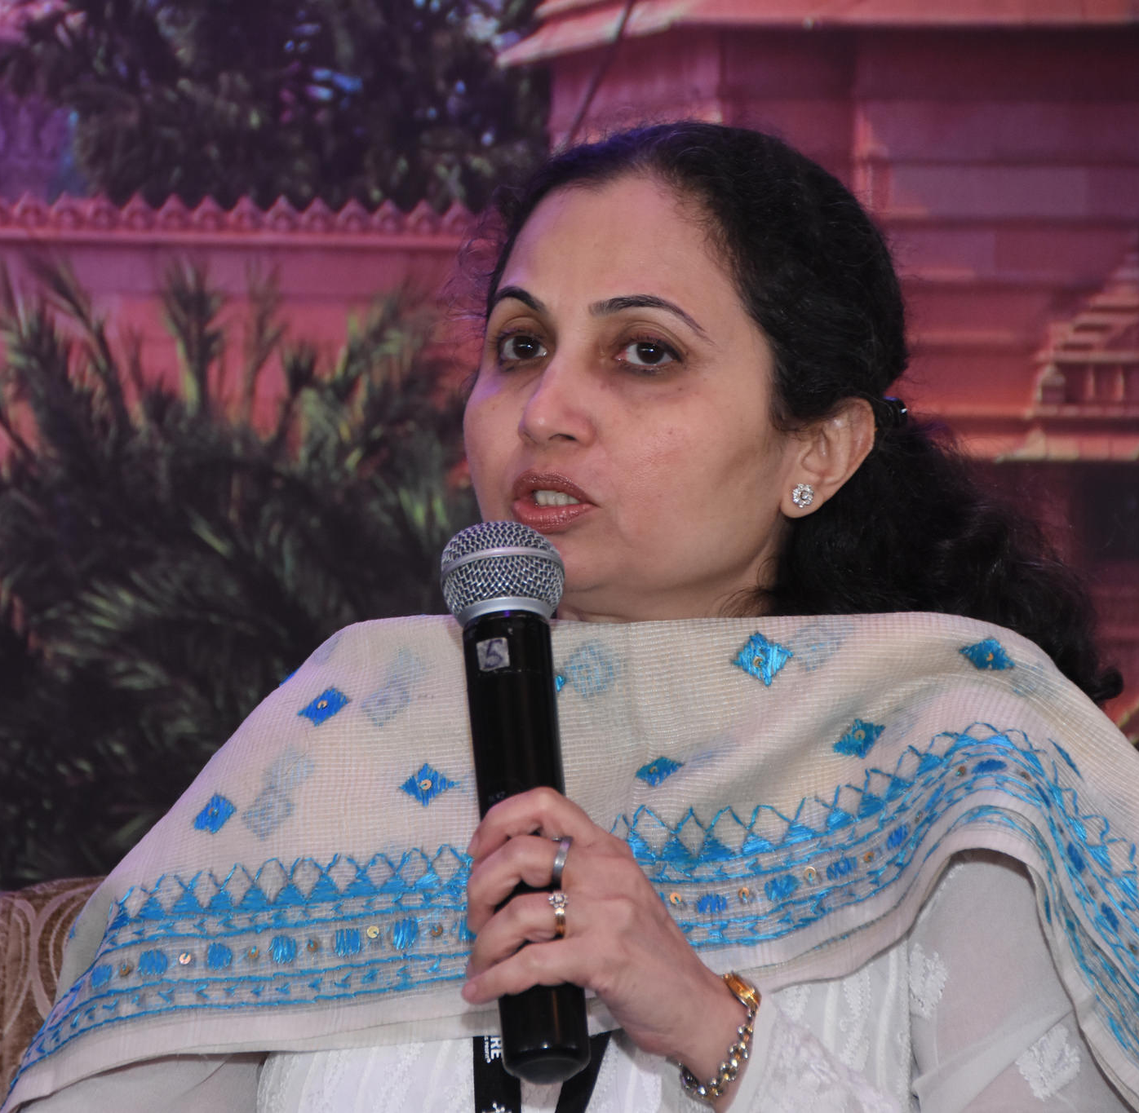
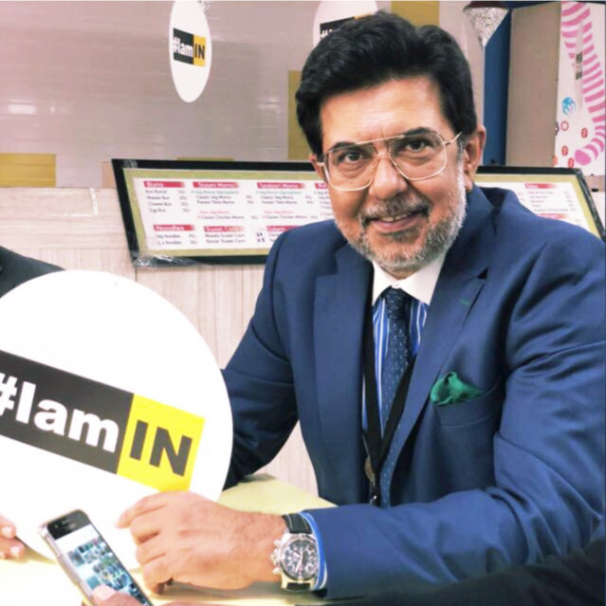
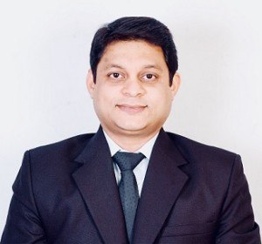
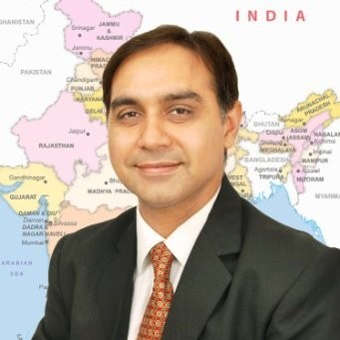
Working Committee
Guidance from BELA South Asia Company Leaders
Shri Atul Kumar, Chief Ethics Officer, SBI
Sandhya Sharma, VP, Corporate Governance, Mahindra
Rajeev Chopra, Managing Director, Legal, Accenture
Pankaj Dahibhate,
E+C Leader,
Cummins India Limited
Sandeep Seth,
Director, Corporate Compliance, Pfizer
Notes:
5

Slide 6
The Current Ethics & Compliance Landscape
Business Case Section 1: Context
Section 1: Context. Macro Global Conditions and the Intersection of the Indian Market
Slides you can use to explore the economic, geopolitical, and social conditions that impact today’s ethical leaders.
Section 2: Inform. Case Studies of Regulatory and Reputational Missteps
Slides you can use to show examples of the costs and consequences of compliance failures.
Section 3: Inspire. Leading with Business Integrity and Creating Advantage
Slides you can use to set the stage and explore why integrity and compliance are so important.
Section 4: Engage. Data, Practices, and Programs of Leading Companies
Slides you can use to provide data-driven evidence of ways to further build your program and engage stakeholders.
Notes:
6

Slide 7
THE LANDSCAPE: TRUST, TRANSPARENCY, TECHNOLOGY, AND CHANGE
We are in the midst of a profound re-ordering of relationships in the global commercial sphere that is leaving no industry or business untouched. Like all business transformations, this one is being fueled by rapid technological change and generational attitudes and behaviors.

Slide 8
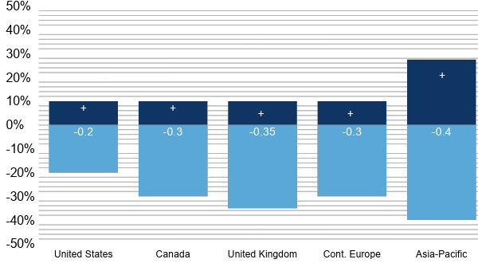
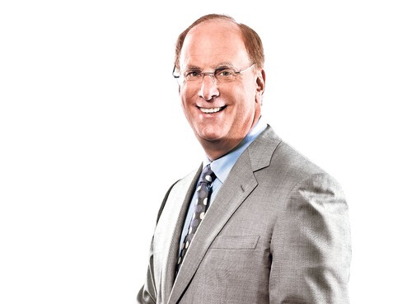
Investors Recognize the Value in Quality Governance and Compliance Practices
A Premium Is Placed on Leading Companies
Impact on Valuation of Superb vs. Poor Corporate Governance
“As investors, we need to use our voice, through direct engagement and voting, to ensure that companies are being run to deliver sustainable growth and returns over the long term.”
“Aligning decision-making with ethical culture reduces long-term risk to the enterprise.”
Median Valuation Premium from Superb Corporate Governance
Median Valuation Discount from Poor Corporate Governance
“A culture of ethics ties long-term performance objectives to the interests of long-term stakeholders.”
Larry Fink
CEO, BlackRock
Source: Rivel’s Corporate Governance Intelligence Council. Governance and Proxy Voting: Attitudes and Practices of the Global Buy-Side. August 2015. https://rivel.com/
Notes:
8

Slide 9
Companies Realize Incentives to Be More Socially Conscious
Case in Point: Avangrid tied $2.5B in loans to sustainable targets
Notes:
9

Slide 10
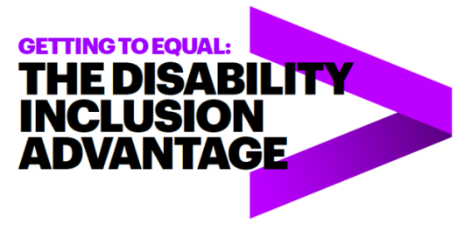
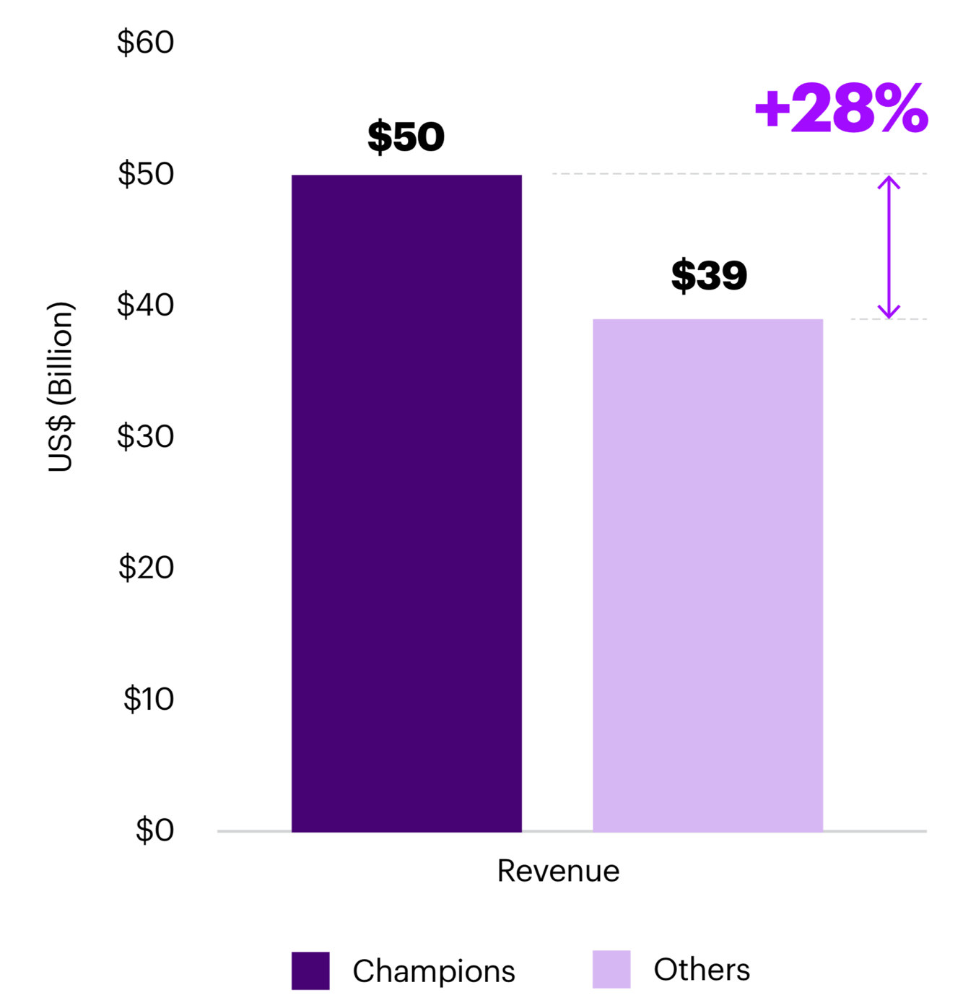
Disability champions outperform on profitability and value creation
Notes:
10

Slide 11
Democracy Is in Retreat
13th consecutive year of decline in global freedom
Source: Freedom in the World 2019 https://freedomhouse.org/report/freedom-world/freedom-world-2019
Notes:
11

Slide 12
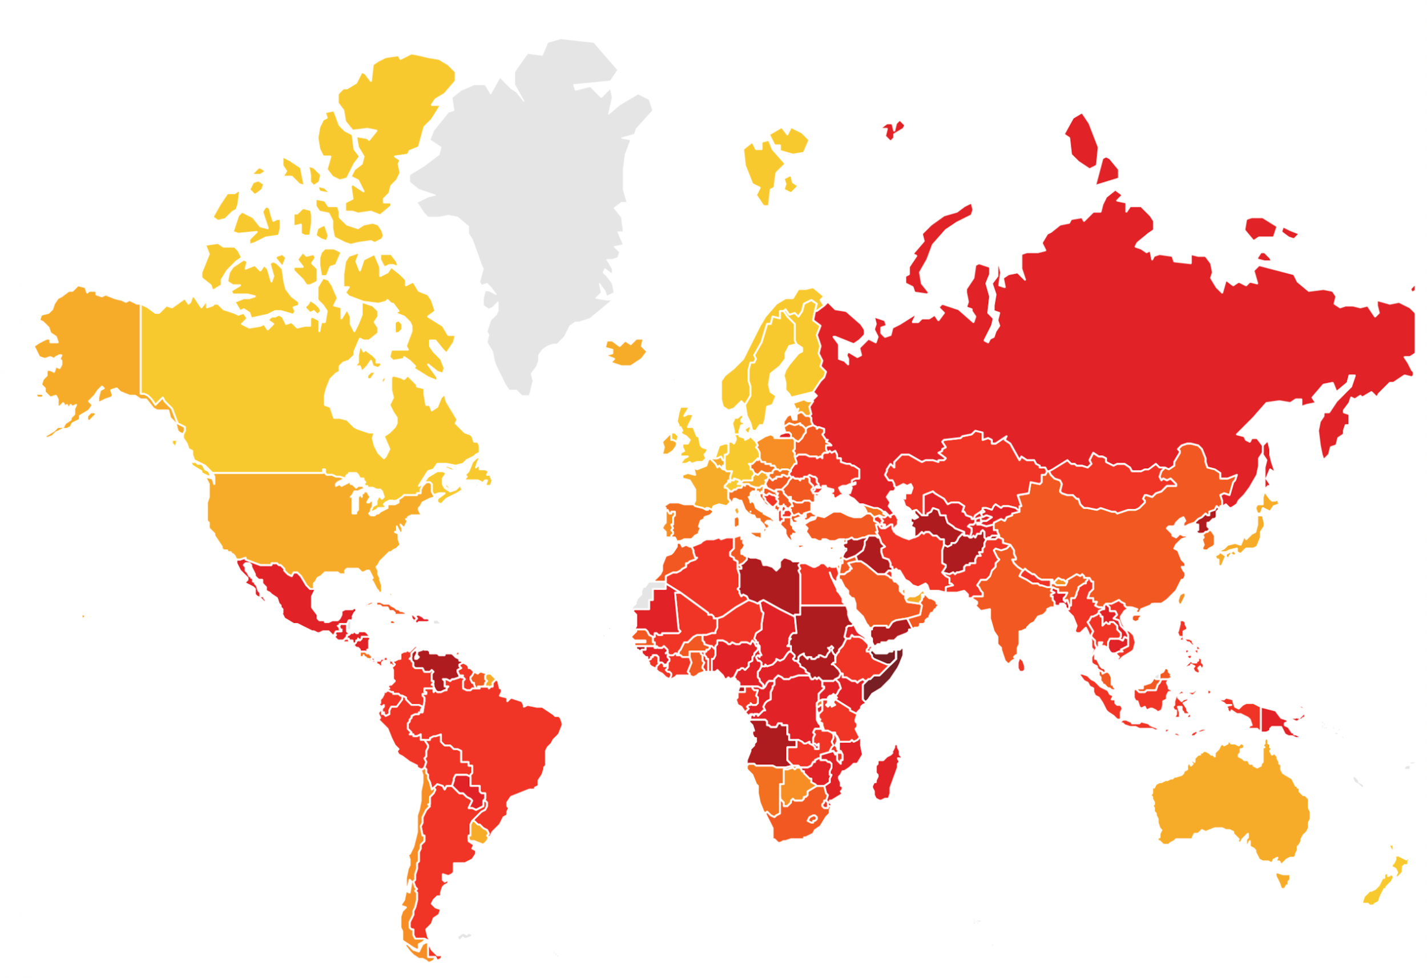
Global Organizations Face Risks Everywhere
What determines success are the processes and procedures in place to deal with these risks, whether known or unknown
Highly
Corrupt
Very
Clean
Source: 2017 Corruption Perceptions Index, Transparency International.
Notes:
12

Slide 13
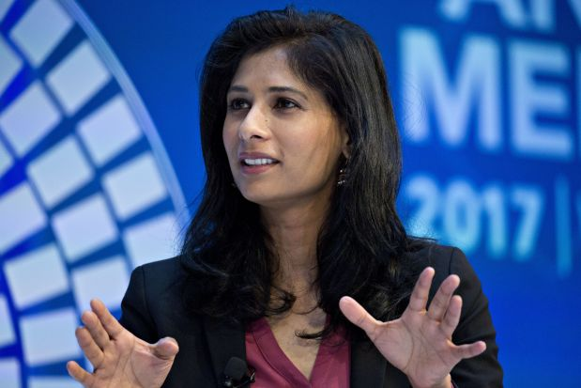
India’s Potential for Growth
“There are growing risks on the trade side and financial conditions. India is earlier in the cycle of growth.”
Gita Gopinath, Chief Economist, IMF
Source: Busiiness Today: https://www.youtube.com/watch?v=sgOcQBzJVo4
Notes:
13

Slide 14
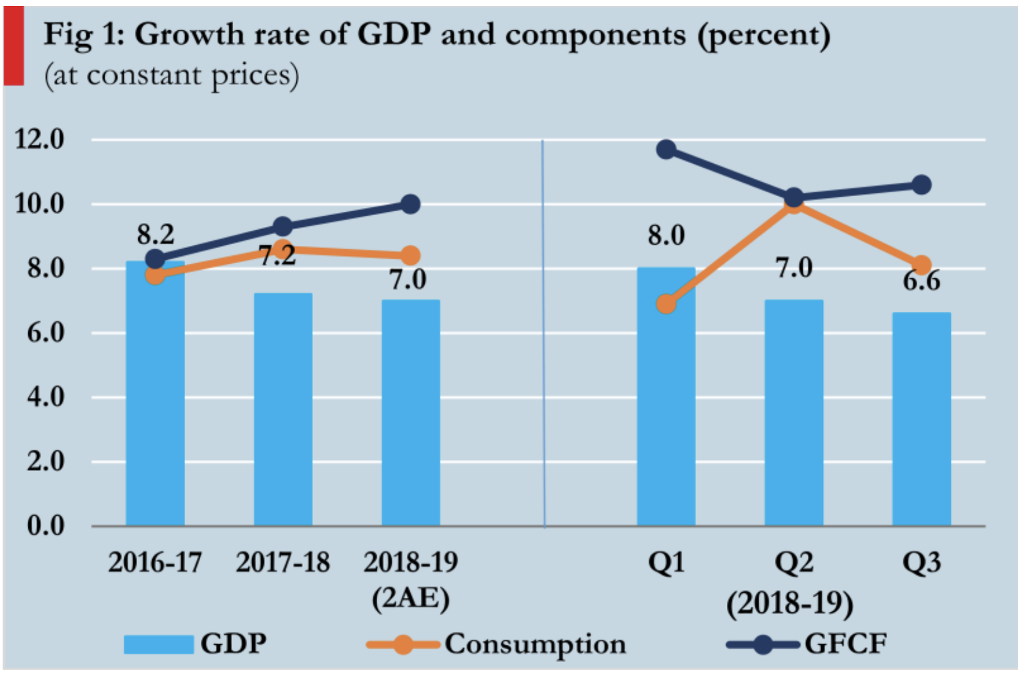
India: Key Economic Indicators – Where We Stand Right Now (2018–2019)
Source: India’s Ministry of Finance: https://dea.gov.in/sites/default/files/MER_January_2019_0.pdf
Notes:
Why is GDP decreasing? Why is the Gross Fixed Capital Formation (GFCF) decreasing, and what does this say about the faith people have in the Indian economy and how the world views us? What is the connection to compliance, ethics, and risk? Are there measures companies or the country can take to shift this trend?
14

Slide 15
Case Studies of Regulatory and Reputational Missteps
Business Case Section 2: Inform
Section 1: Context. Macro Global Conditions and the Intersection of the Indian Market
Slides you can use to explore the economic, geopolitical, and social conditions that impact today’s ethical leaders.
Section 2: Inform. Case Studies of Regulatory and Reputational Missteps
Slides you can use to show examples of the costs and consequences of compliance failures.
Section 3: Inspire. Leading with Business Integrity and Creating Advantage
Slides you can use to set the stage and explore why integrity and compliance are so important.
Section 4: Engage. Data, Practices, and Programs of Leading Companies
Slides you can use to provide data-driven evidence of ways to further build your program and engage stakeholders.
Notes:
15

Slide 16
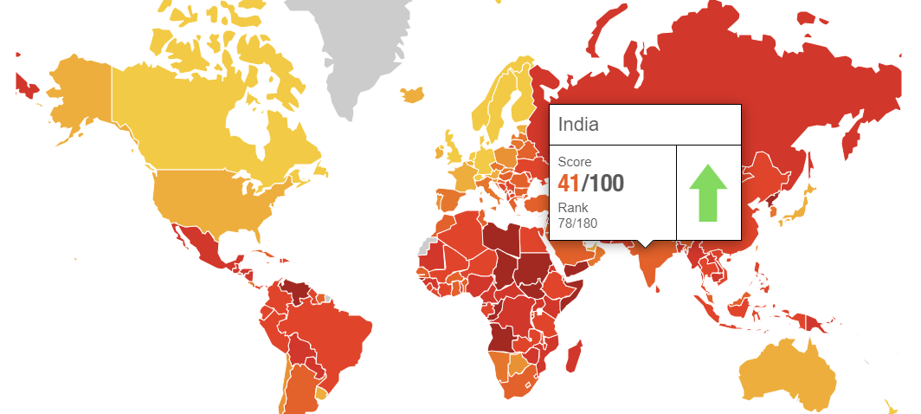
India’s Corruption Risk Landscape Still Persistent
India has experienced incremental improvement in perceived corruption risk, with a Transparency International ranking up to 78 (in 2018) from 81 (2017) out of 180 countries. Yet India is still among the two-thirds of countries that score below 50 on the Corruption Perceptions Index.
Highly
Corrupt
Very
Clean
Source: 2018 Corruption Perceptions Index, Transparency International.
Notes:
16

Slide 17
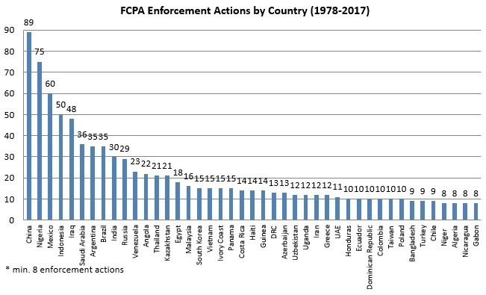
FCPA Actions in India: 30
Source: Gibson Dun
Notes:
17

Slide 18
India: 2017 – FCPA Offenses in India
Mondelēz International, Inc.
In 2017, Mondelēz International, Inc. agreed to pay $13 million to resolve FCPA offenses related to payments by its Cadbury unit in India. The offenses occurred in connection with payments to a local agent to obtain government licenses and approvals for a chocolate factory in Baddi, India. Mondelēz, formerly known as Kraft Foods, Inc., acquired Cadbury Limited and its subsidiaries, including Cadbury India Limited, in February 2010. Cadbury India paid the agent to deal with Indian government officials to obtain licenses and approvals.
CDM Smith Inc.
Privately held CDM Smith Inc. entered into a declination with disgorgement with the Justice Department to resolve FCPA offenses in India. The DOJ said employees and agents of CDM Smith and a wholly owned subsidiary in India paid $1.18 million in bribes to government officials. In return, the company won highway construction supervision and design contracts and a water project contract. The DOJ said the bribery in India occurred from 2011 to 2015.
Source: FCPA Blog: http://www.fcpablog.com
Notes:
18

Slide 19
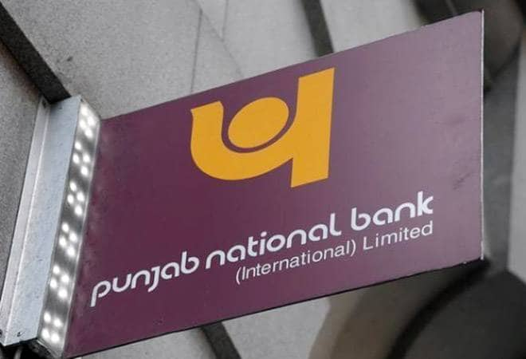
India: 2018 – Corruption and Fraud
Punjab National Bank (PNB)
A $2 billion fraud at India’s Punjab National Bank may have been orchestrated by a few rogue employees, but it escaped detection because of widespread risk-control and monitoring lapses in many areas of the bank, the bank’s own internal probe has found. PNB, India’s second-biggest state-controlled lender, has previously alleged that a handful of staff at a single Mumbai branch issued fake bank guarantees to help two jewellery groups - controlled by Indian diamond magnate Nirav Modi and his uncle Mehul Choksi - raise billions of dollars in foreign credit and commit India’s biggest-ever bank fraud.
Air Asia India 2018
The Central Bureau of Investigation (CBI) on Tuesday booked AirAsia’s group chief executive officer (CEO) Anthony “Tony” Fernandes, who is one of the richest men in Malaysia, and five others, accusing them of “intentionally” choosing to beat the legal framework and aviation sector policies in India to secure some mandatory approvals for the airline “through non-transparent means” and attempting for a “removal/modification of 5/20 rule.”
Source: Reuters
Notes:
19

Slide 20
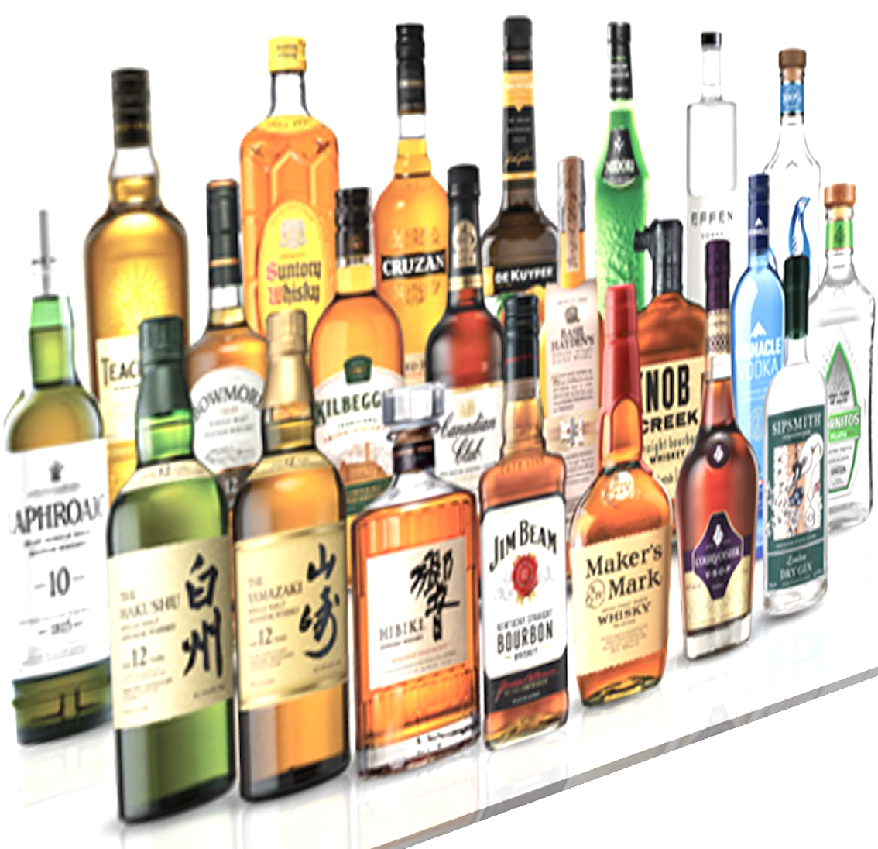
India: 2018 – Corruption and Fraud
Beam Suntory Inc.
Chicago-based spirits maker Beam Suntory Inc. agreed to pay more than $8 million to resolve Foreign Corrupt Practices Act charges for improper payments by its Indian subsidiary. According to the SEC’s order, from 2006 through 2012 Beam’s Indian subsidiary “used third-party sales promoters and distributors to make illicit payments to government employees.” The purpose was to "increase sales orders, process license and label registrations, and facilitate the distribution of Beam’s distilled spirit products.”
Canara Bank
The UK Financial Conduct Authority fined India's Canara Bank about $1.2 million for a series of AML failures and barred it from accepting deposits from new customers for nearly five months. The FCA said it scored Canara's misconduct “as a level four out of five on our scale of seriousness.” The bank seconded staff from India to the UK for three years to fill senior management positions, which contributed to the compliance failures.
Source: FCPA Blog
Notes:
20

Slide 21
India: 2018 – Corruption and Fraud
Stryker 2018
Medical device maker Stryker Corp. agreed Friday to pay the SEC a $7.8 million penalty to resolve FCPA books and records and internal accounting controls offenses in India, China, and Kuwait.
It's the second time the SEC has brought an FCPA action against the Michigan-based company. Stryker agreed to the settlement without admitting or denying the SEC’s findings.
The SEC said Stryker’s internal accounting controls weren't sufficient "to detect the risk of improper payments in sales of Stryker products" in the three countries.
In India, for example, some of Stryker's dealers regularly issued inflated invoices "upon the request of certain private hospitals," the SEC said.
The private hospitals passed the inflated invoices on to their patients or their patients’ insurers, "even as the hospitals paid the lower prices previously negotiated with Stryker India to Stryker India’s dealers."
Source: FCPA Blog
Notes:
21

Slide 22
India: 2019 – A Year of High Profile Cases
Uber Technologies (2019)
In April 2019, Uber Technologies, Inc. said the US Department of Justice is investigating possible FCPA violations related to its activity in Asia.
According to Uber's S-1 filing, the DoJ is investigating potential bribes in countries including Indonesia, Malaysia, China, and India. “The investigation is ongoing, and we are cooperating with the DoJ in this investigation,” Uber said. “We may be subject to criminal sanctions and other liabilities, which would adversely affect our business, financial condition, and operating results.”
Cognizant Technology Solutions Corporation
In February 2019, Cognizant Technology Solutions Corporation agreed to pay $25 million to settle FCPA charges with the SEC, and two of the company’s former executives were charged by the DOJ for paying bribes to an Indian government official. The company agreed to pay disgorgement and prejudgment interest of around $19 million and a penalty of $6 million.
Source: FCPA Blog
Notes:
22

Slide 23
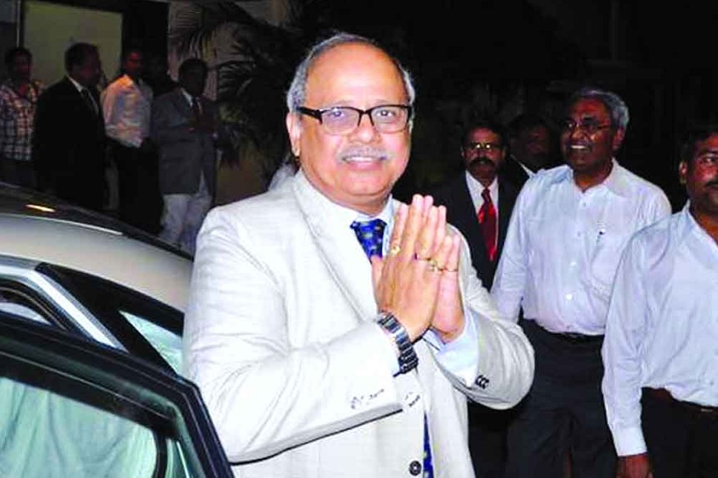
India: 2019 – India Appoints First Anti-Corruption Ombudsman
On March 19, 2019, Indian President Ram Nath Kovind cleared the
way for former Indian Supreme Court Justice Pinaki Chandra
Ghose to become the first anti-corruption ombudsman, or Lokpal,
of India. Ghose was appointed under the Lokpal Act, which
authorizes the Lokpal to investigate corruption allegations
against any public official, other than officials in the armed
forces.
Although the act was passed in 2013, no ombudsman had been appointed until the Indian Supreme Court ordered the Indian government to appoint a Lokpal in January 2019. India, which ranked 78th out of 180 countries on the 2018 Transparency International Corruption Perception Index, is predicted to be the fastest growing major economy in the world over the next two years.
Source: Morrison Foerster: https://bit.ly/2Ld7znJ
Notes:
23

Slide 24
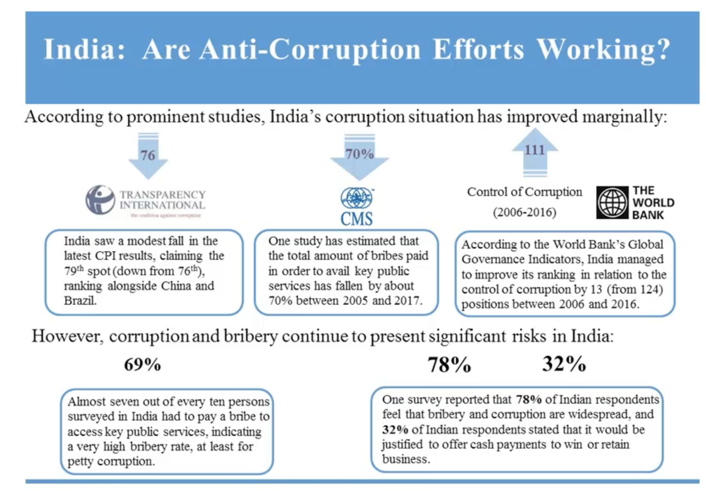
Despite Marginal Improvement, Corruption Cases Are Still Prominent Across a Wide Range of Business Activity
Source: “2018 FCPA Trends in Emerging Markets” Gibson Dunn
Notes:
24

Slide 25
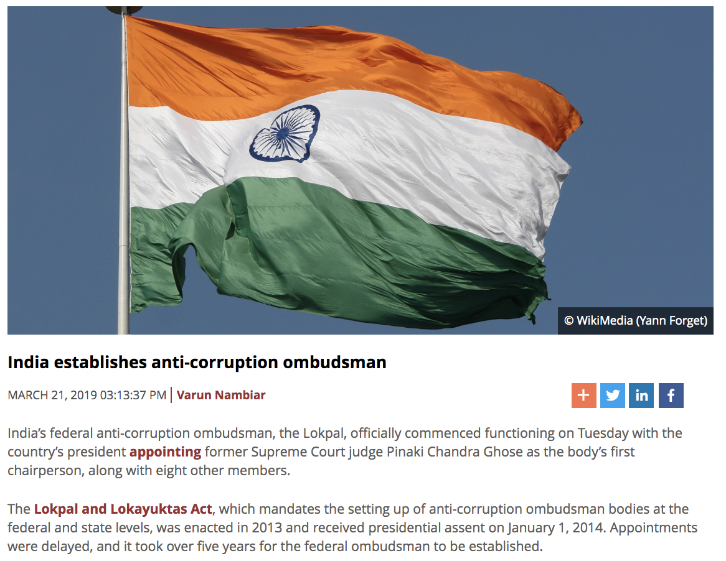
Regulatory Changes in India: The Lokpal and Lokayuktas Act
Under Section 3 of the statute, the Lokpal chairperson may be a current or former Chief Justice of India. The body may also be chaired by a person who is or has been a judge of the Supreme Court, or an “eminent person of impeccable integrity,” with special knowledge and expertise in matters relating to “anti-corruption policy, public administration, vigilance, finance including insurance and banking, law and management.”
Source: Jurist
Notes:
25

Slide 26
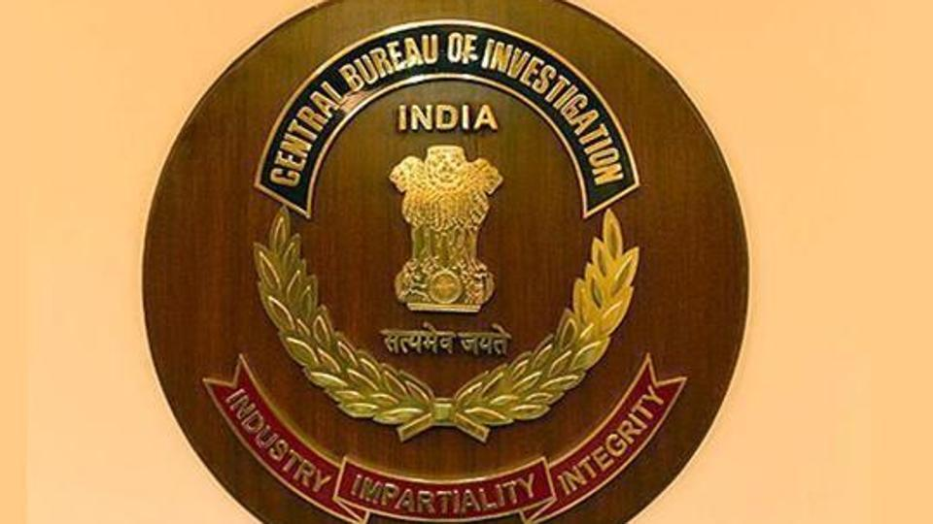
CBI Registered 206 Corruption Cases Against Central Government Employees
The CBI has registered 206 cases of corruption against
central government employees between January and November 2018, according to Minister of State for Personnel Jitendra Singh
2017: 338 cases were registered
Charge sheets filed:
2015: 361
2016: 272
2017: 168
Source: Central Bureau of Investigation (CBI)
Notes:
26

Slide 27
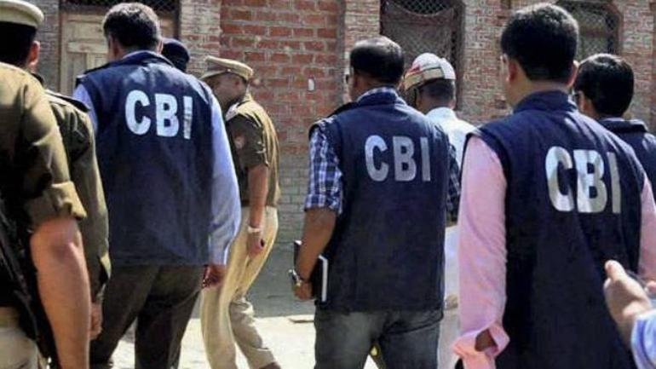
Enforcement Agencies Have Demonstrated More Aggressive Pursuit of Systemic Corruption
Earlier this year, the Central Bureau of Investigations took into custody six people, including one Sports Authority of India (SAI) Director S K Sharma, and three officials, in connection with a case of alleged corruption.
It is alleged that bills of Rs 19 lakh were pending to be cleared by SAI officials.
Source: India Today
Notes:
27

Slide 28
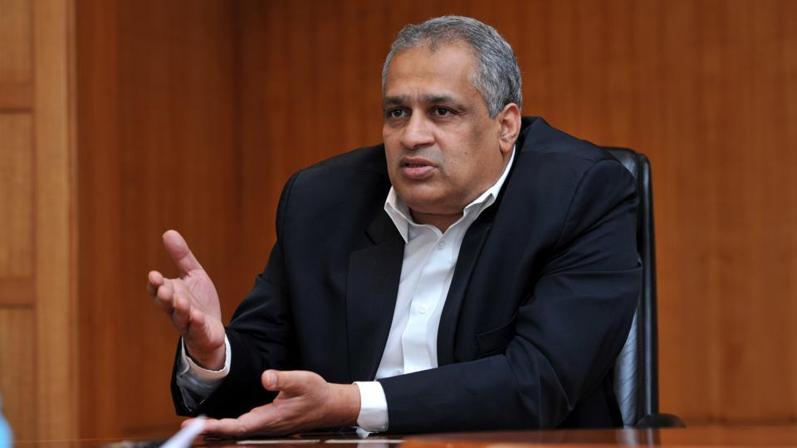
India’s Serious Fraud Investigation Office (SFIO) Made Its First Arrest Linked to the Default of IL&FS
In April 2019, the body remanded Hari Sankaran, the former chairman and the managing director of the infrastructure lender, under Section 447 of the Companies Act, which deals with fraud.
Source: Business Insider India
Notes:
28

Slide 29
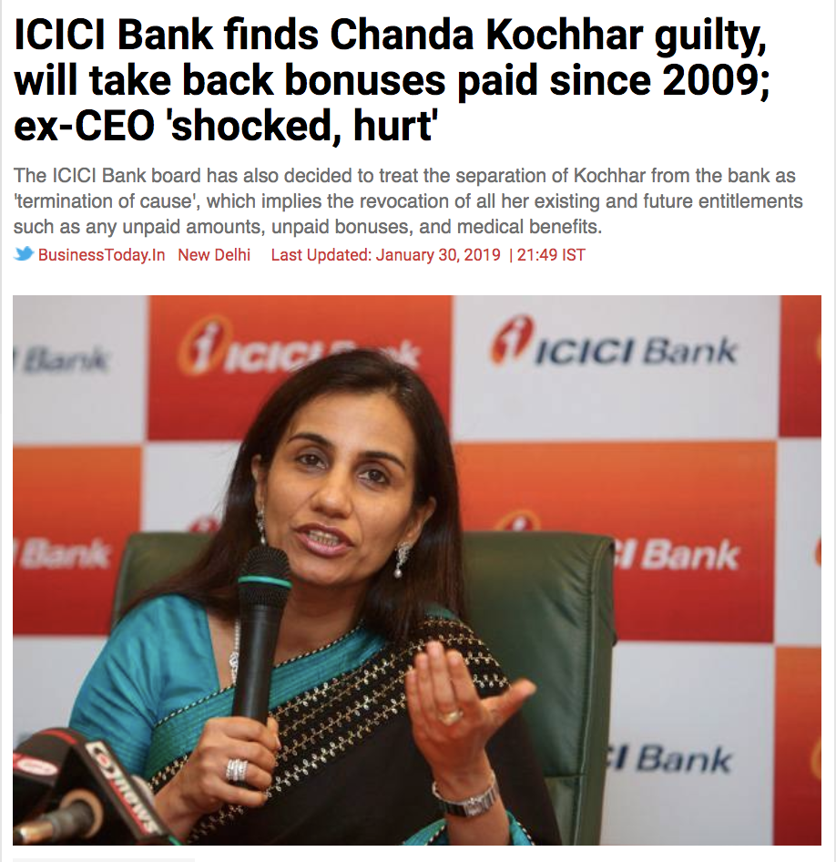
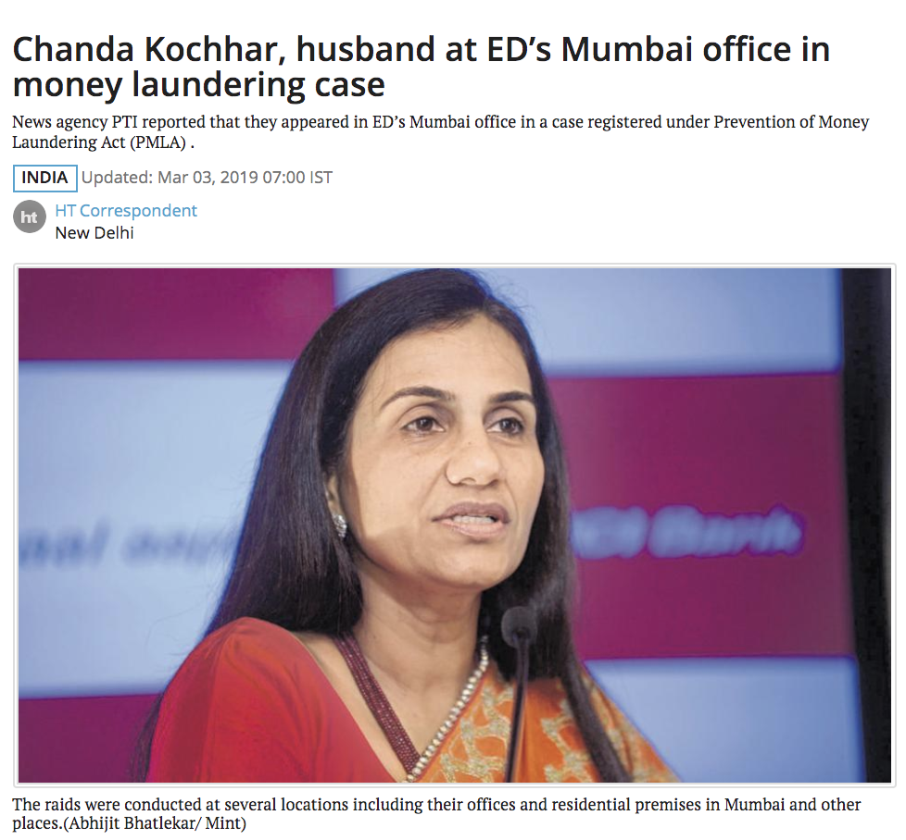
Individual Accountability on the Rise, as Bad Actors Are No Longer Able to Hide Behind the Company
Source: Business Today and Hindustan Times
Notes:
29

Slide 30
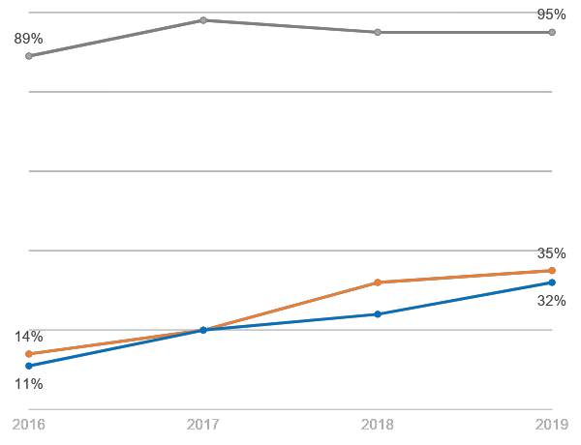
Establishing Trust Through Transparent Reporting
World’s Most Ethical Companies honorees communicating the number, types, and outcomes of reported concerns and investigations
Honorees are in near universal agreement that sharing reporting and investigations data outside of board meetings is a best practice
The rate of honorees sharing this information with all employees has increased 2.5x
And those communicating about reporting and investigations publicly has jumped nearly 3x
Source: 2019 World’s Most Ethical Companies Data Set. Ethisphere
Notes:
This question was not asked in EQ 2015 or earlier
30

Slide 31
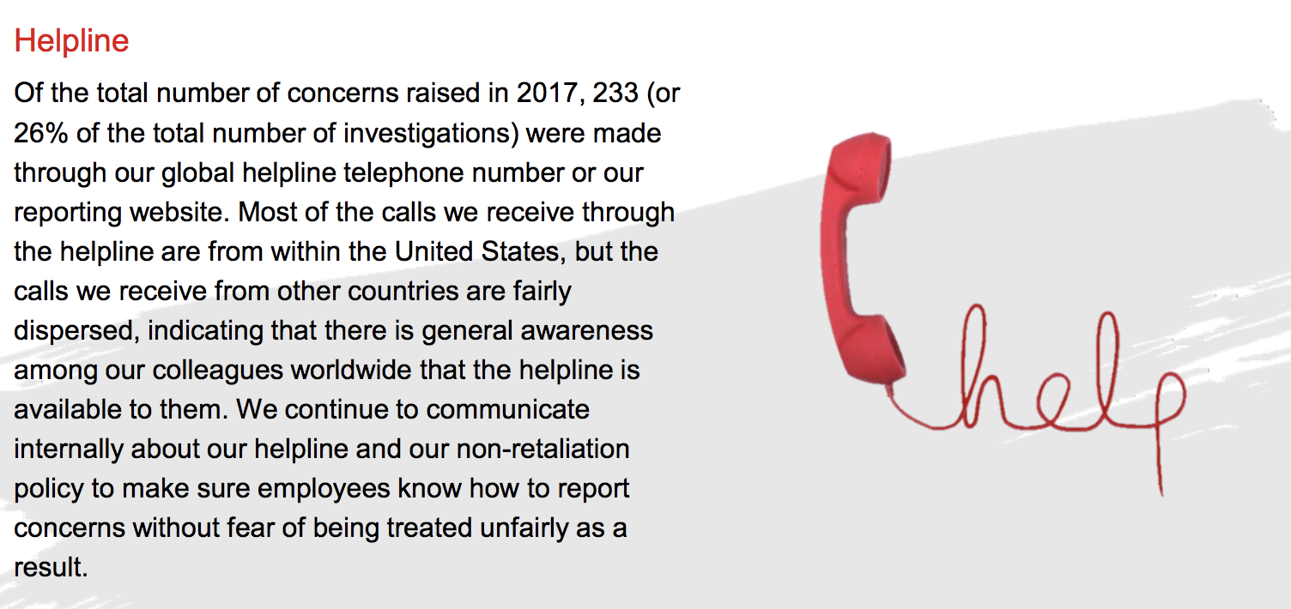
JLL: Ethics Everywhere Program Components
Source: https://www.us.jll.com/content/dam/jll-com/images/company-information/2017-Ethics-Everywhere-Annual-Report.pdf
Notes:
This question was not asked in EQ 2015 or earlier
31

Slide 32
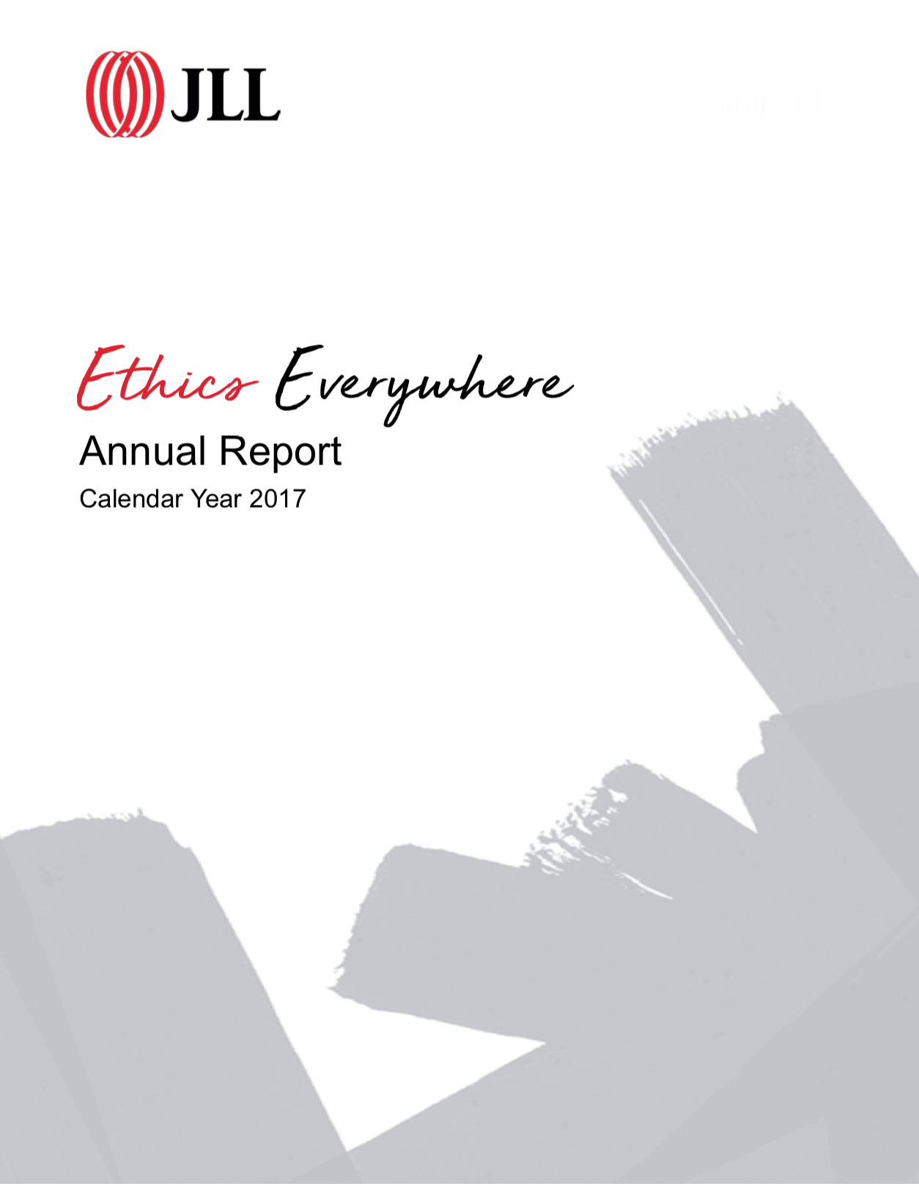
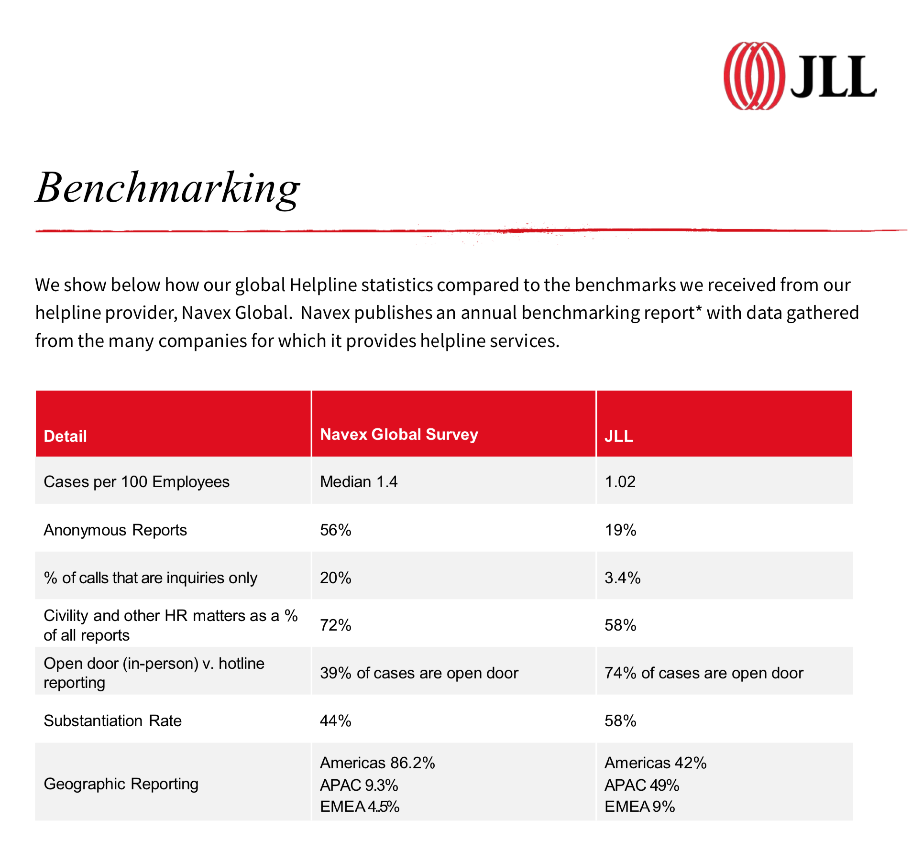
Establishing Trust Through Transparent Reporting
Source: https://www.us.jll.com/content/dam/jll-com/images/company-information/2017-Ethics-Everywhere-Annual-Report.pdf
Notes:
This question was not asked in EQ 2015 or earlier
32

Slide 33
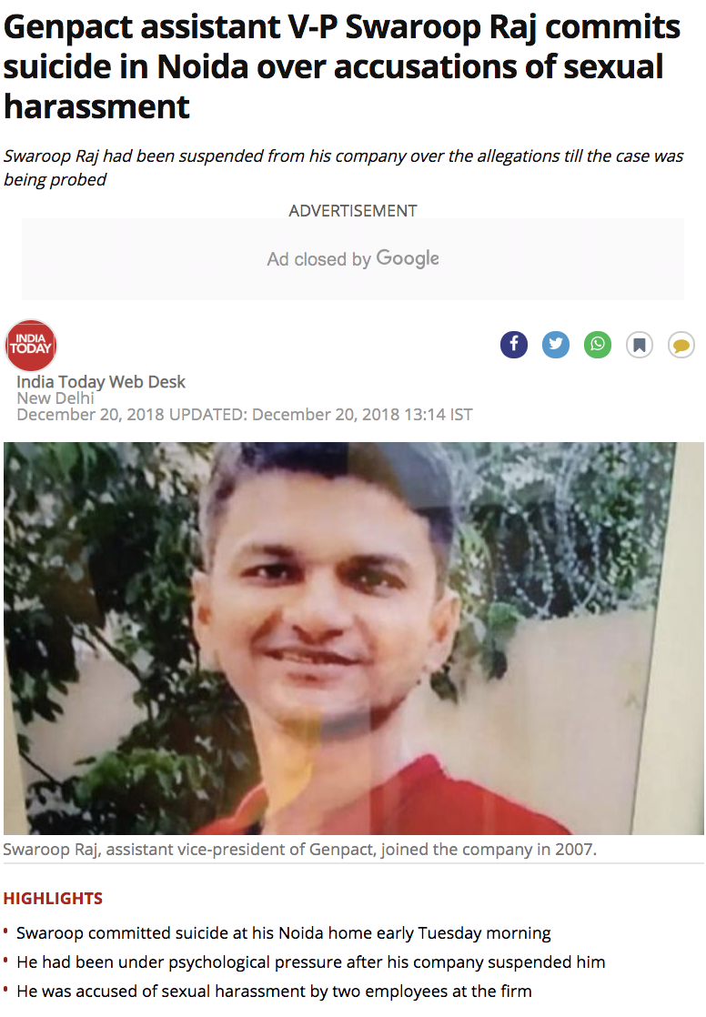
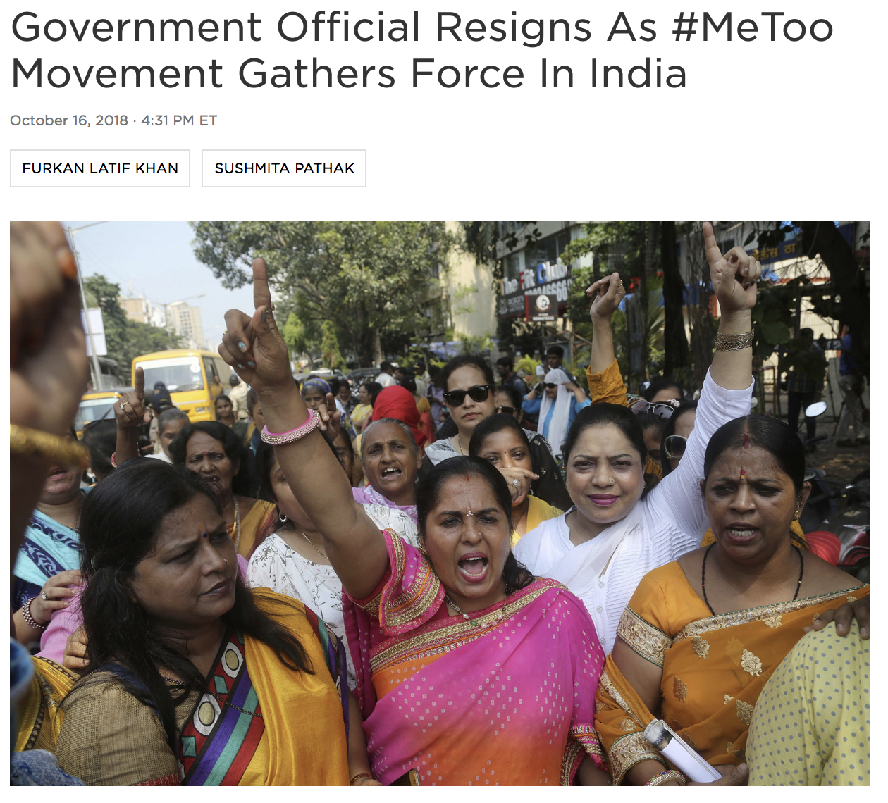
The #MeToo Movement Has Amplified Concerns About Workplace Conduct Throughout the Region
Source: India Today
Source: NPR
Source: The New York Times
Notes:
33

Slide 34
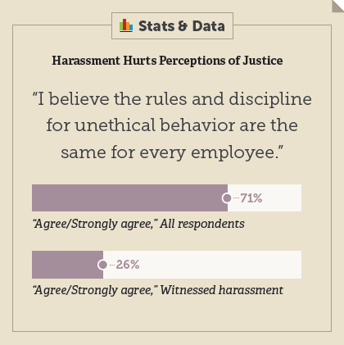
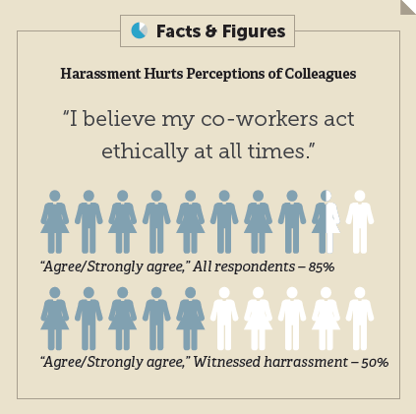
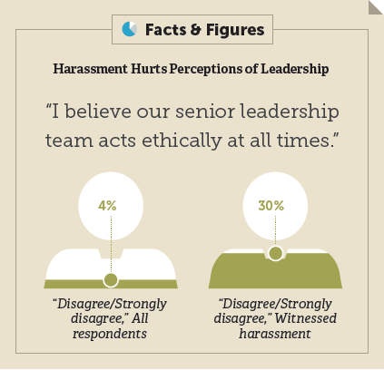
Impact of Harassment on Employee Attitudes
Sense of organizational justice harmed by harassment
Victims and witnesses less likely to trust co-workers and leadership
Victims more likely to leave; impact on health and well-being
Source: Ethisphere special report, #MeToo: A Year Into a Movement
Notes:
34

Slide 35
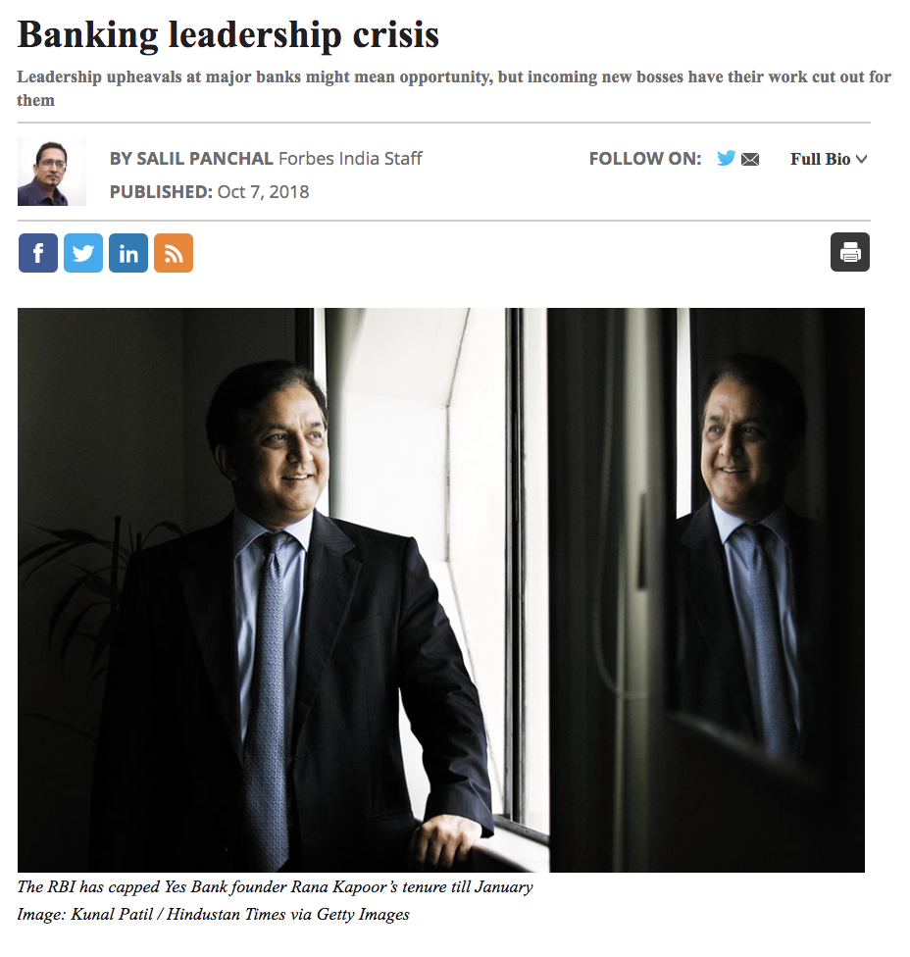
Leadership in Certain Sectors Is Facing Significant Disruption
“The exits of the leaders of three banks—Chanda Kochhar, former managing director and CEO of ICICI Bank, Shikha Sharma,
CEO of Axis Bank, and Yes Bank’s MD and CEO Rana Kapoor—are against their wishes.”
Forbes India
Source: Forbes India
Notes:
35

Slide 36
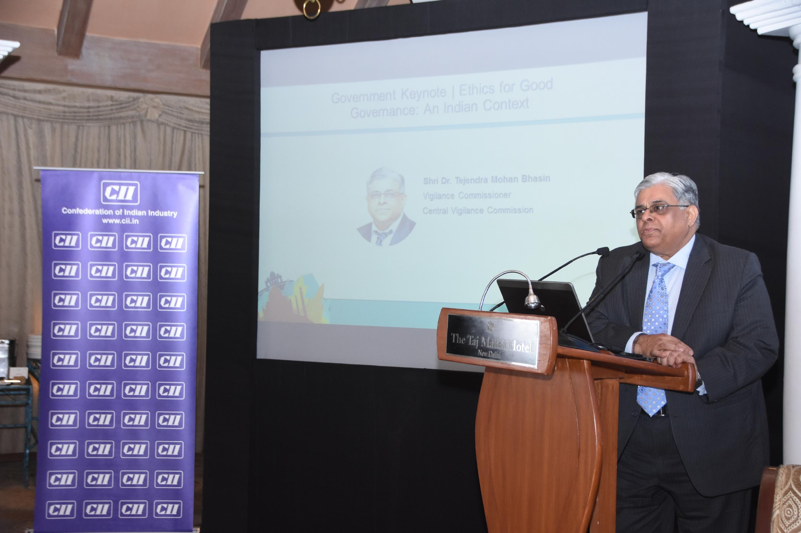
To Make a Difference, Companies Must Take a Stand
“We are all aware that righteousness is the foundation of good governance. Ethics in governance means probity in conducting business with transparency and accountability.”
Shri Dr. Tejendra Mohan Bhasin, Central Vigilance Commission
Source: Ethisphere’s 2018 South Asia Ethics Summit
Notes:
36

Slide 37
The Advantages of Doing Business with Integrity
Business Case Section 3: Inspire
Section 1: Context. Macro Global Conditions and the Intersection of the Indian Market
Slides you can use to explore the economic, geopolitical, and social conditions that impact today’s ethical leaders.
Section 2: Inform. Case Studies of Regulatory and Reputational Missteps
Slides you can use to show examples of the costs and consequences of compliance failures.
Section 3: Inspire. Leading with Business Activity and Creating Advantage
Slides you can use to set the stage and explore why integrity and compliance are so important.
Section 4: Engage. Data, Practices, and Programs of Leading Companies
Slides you can use to provide data-driven evidence of ways to further build your program and engage stakeholders.
Notes:
37

Slide 38
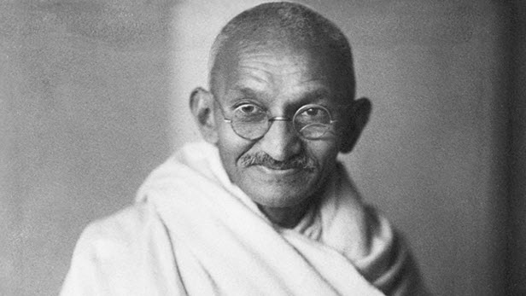
“
Be the change that you wish to see in the world.
”
Mahatma Gandhi
Notes:
38

Slide 39
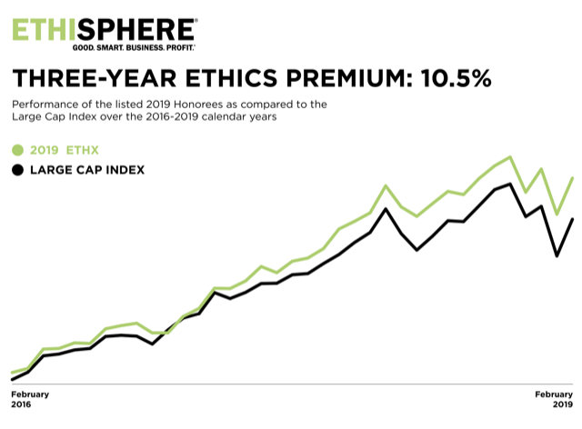
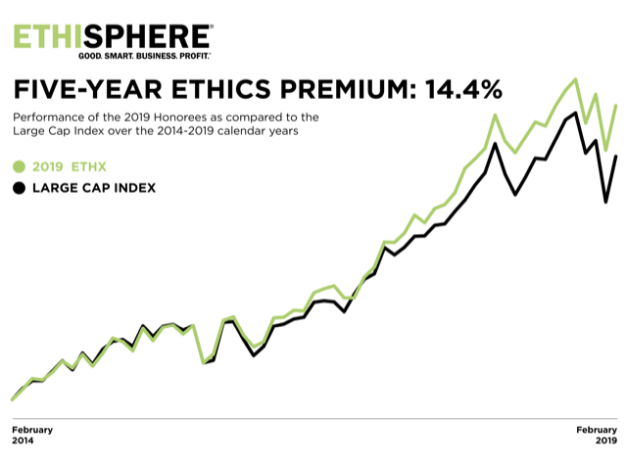
Ethical Leadership Has Other Rewards…
The World’s Most Ethical Companies® Outperform the Market
Notes:
39

Slide 40
CII: Model Code of Conduct
Source: The Confederation of Indian Industry. https://www.cii.in/About.aspx
Notes:
The Confederation of Indian Industry considers "Ethical Practices in Business Dealings" to be critical for the development and growth of industry in India.

Slide 41
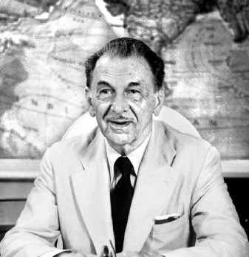
J.R.D TATA on the Business of Ethics and Integrity
"We do not claim to be more unselfish, more generous or more philanthropic than other people. But we think we started on sound and straightforward business principles, considering the interests of the shareholders our own, and the health and welfare of the employees the sure foundation of our prosperity.”
Jehangir Ratanji Dadabhoy Tata
Source: The Hindu

Slide 42
Employers: Most Trusted Relationship

Slide 43
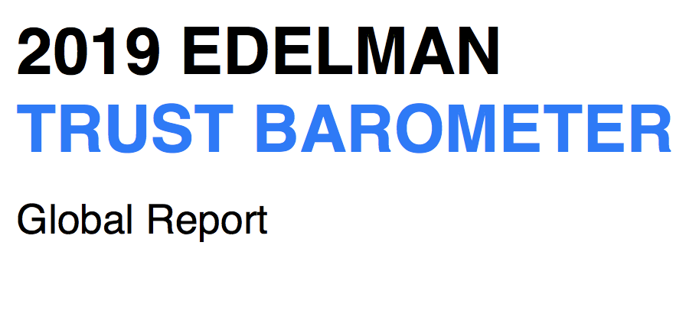
CEOs Emerging As A Voice

Slide 44
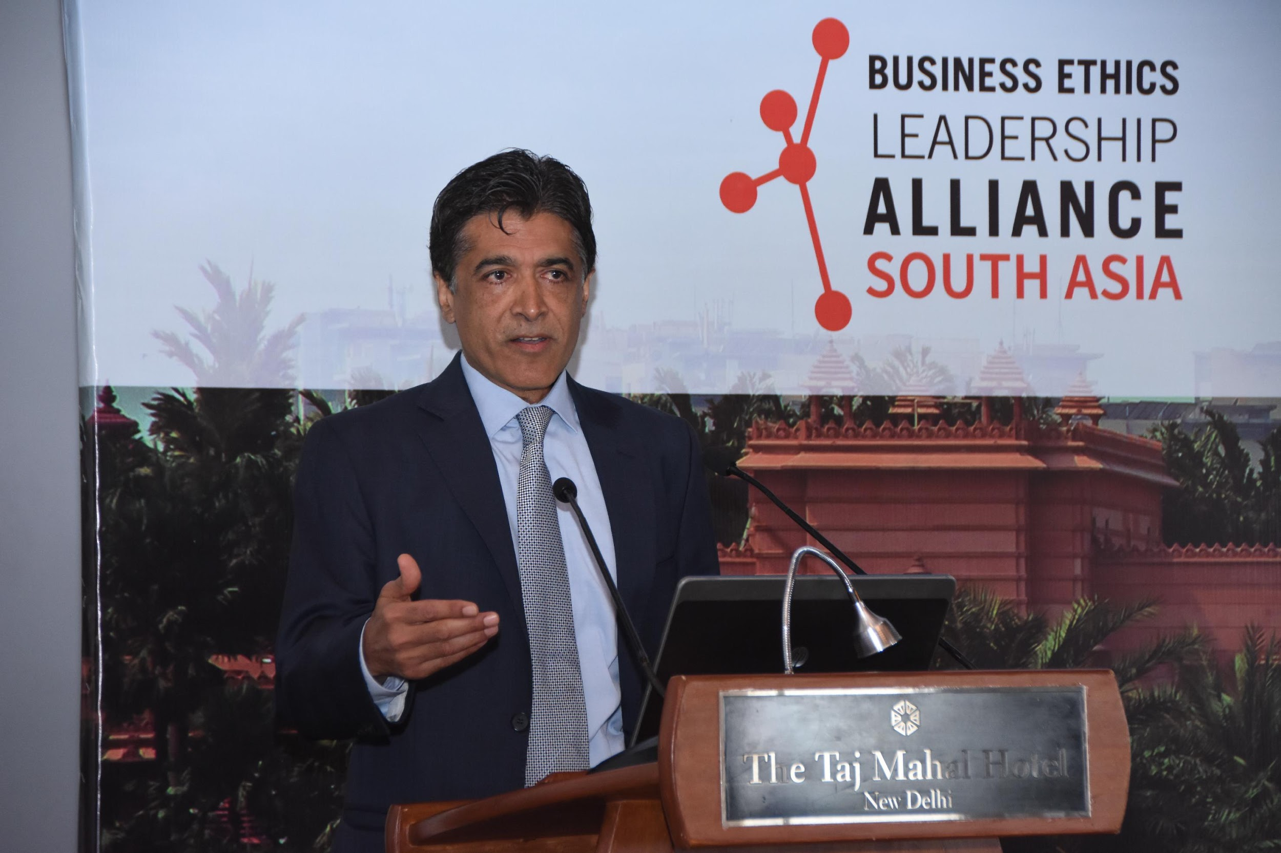
Building Trust and Taking Action as Leaders
“The biggest role of leadership is to ensure we are taking the opportunities that are presented to take action, or make a comment, that sets the stage for how we want people to operate—in a way that builds trust.”
Vishal Wanchoo, President and CEO, South Asia, GE

Slide 45
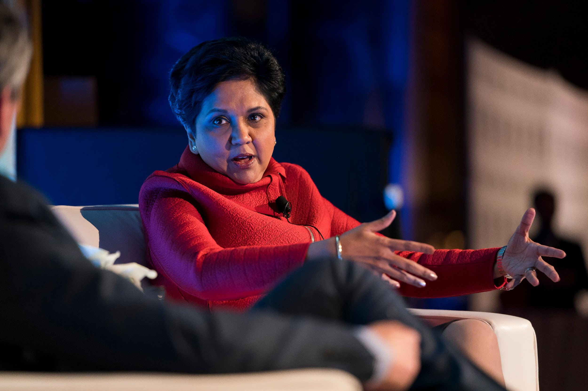
Leadership Is Hard to Define, and Good Leadership Is Even Harder
“I wouldn’t ask anyone to do anything I wouldn’t do myself.”
Indra Nooyi, Board of Directors, Amazon, and Former Chairman and CEO, PepsiCo

Slide 46
Anand Mahindra on Good Governance & Ethics | Mahindra Rise
“We believe that doing things the right way is just as important as doing the right things.”
Anand Mahindra, Chairman, Mahindra Group
Source: https://www.youtube.com/watch?v=SRu1ADplVuM
Notes:
46

Slide 47
Programs and Practices of Leading Companies
Business Case Section 4: Engage
Section 1: Context. Macro Global Conditions and the Intersection of the Indian Market
Slides you can use to explore the economic, geopolitical, and social conditions that impact today’s ethical leaders.
Section 2: Inform. Case Studies of Regulatory and Reputational Missteps
Slides you can use to show examples of the costs and consequences of compliance failures.
Section 3: Inspire. Leading with Business Integrity and Creating Advantage
Slides you can use to set the stage and explore why integrity and compliance are so important.
Section 4: Engage. Data, Practices, and Programs Behind Leading Companies
Slides you can use to provide data-driven evidence of ways to further build your program and engage stakeholders.

Slide 48
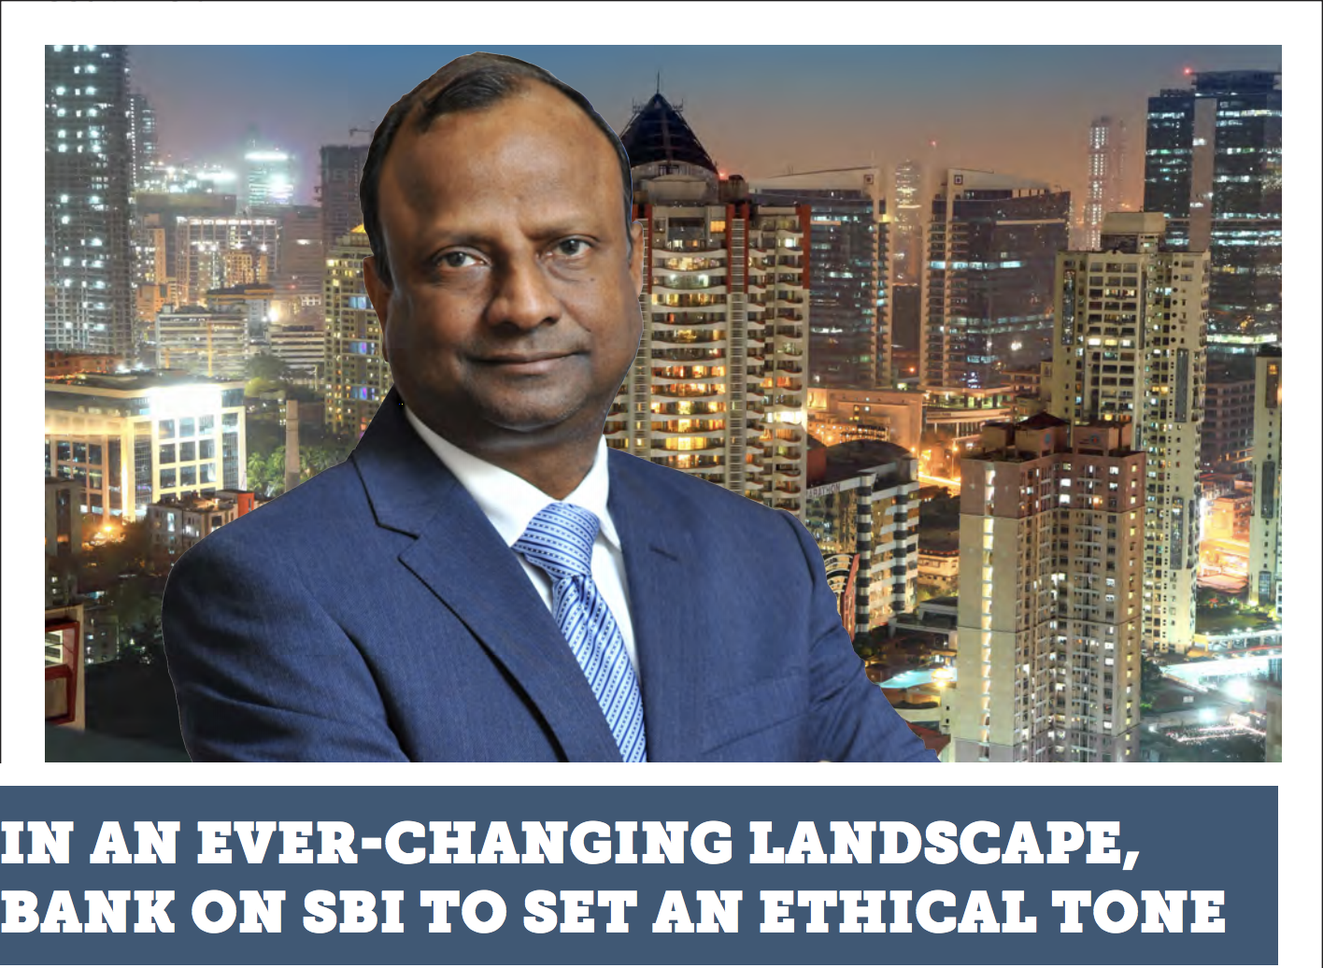
How India’s Largest Bank Created an Independent Ethics Function
“Ethics is not something that can be forced upon someone. It must come from within. The best that can be done in this regard is to create an ethical infrastructure that promptly hears you when you have a dilemma, guides you when in need, and is geared to identify, correct, or punish ethical lapses.” – Shri Rajnish Kumar, Chairman, SBI
Source: BELA South Asia Magazine: https://insights.ethisphere.com/wp-content/uploads/SA-Ethisphere-Mag-Full-Web.pdf

Slide 49
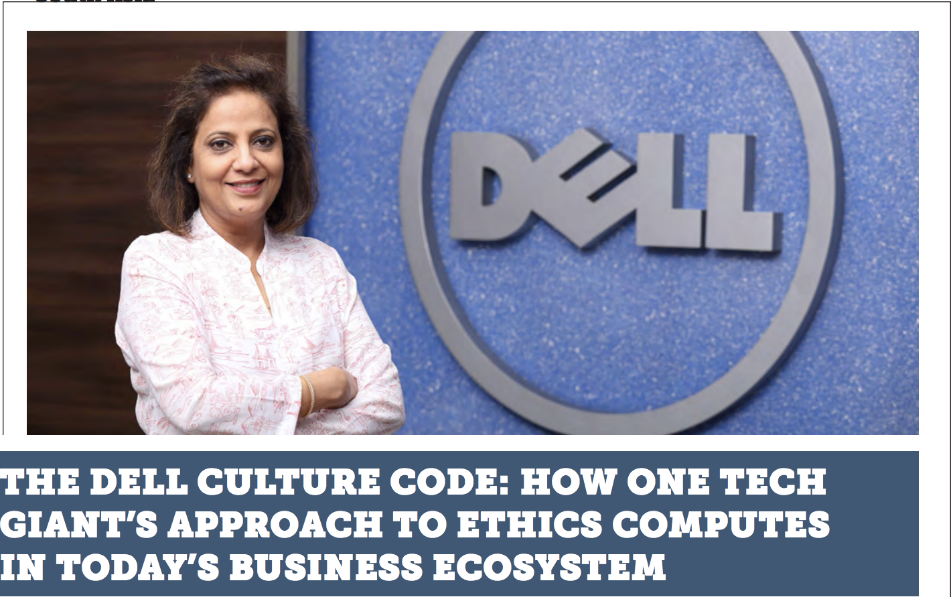
Leadership at All levels is Front and Center in Driving and Sustaining an Ethical Environment
“I have been part of Dell for almost a decade now, and I strongly believe that for a company to succeed, its leaders need to drive the right level of engagement (ethical or otherwise) among their teams. A successful company is one where the leaders and the team drive the culture of the business together. Integral to the Dell culture is the Dell way of doing business, which is essentially doing the right things and doing things right.” – Archana Sasan, Vice President, Dell, India Legal and Ethics.
Source: BELA South Asia Magazine: https://insights.ethisphere.com/wp-content/uploads/SA-Ethisphere-Mag-Full-Web.pdf

Slide 50
Pfizer India Best Practices: An Effective Compliance Program
“Integrity is one of our fundamental values at Pfizer. We never compromise integrity in our decision making or in pursuit of our business goals. Integrity is key to delivering on our commitments, priorities and strategies. When we measure our performance against our business goals, we are equally focused on how we achieve the results as we are on whether we achieve them.”
In todays complex environment , it is more challenging to keep our ethics & compliance program effective and engaging than to create one. Once we have all the essential elements of a good framework in place i.e. Governance, Culture, Training, Monitoring , Policies, Risk Assessment and Investigations , we follow below approaches to keep it more engaging & effective.
Being proactive, ahead of the curve to address internal & external risks.
Embedding compliance into business & people processes.
Following system based approach -create controls & controlling those controls.
Enabling & creating compliance champions and embed culture at grassroots.
Using innovative & engaging mode of education – making compliance a way of life.
Ensuring ‘tone from the top’ and active engagement of leaders.
Overall, act as a strategic partner and part of mainstream of business operations.
Sandeep Seth,
Director, Corporate Compliance, Pfizer

Slide 51
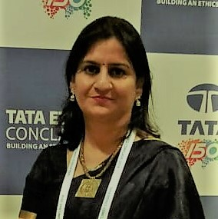
TATA Steel Best Practices: Building A Compliance Framework
“The name ‘Tata’ stands for ‘Trust,’ which has been build over more than 100 years. We are driven by [our] founder’s values which is the foundation of our organization. In the pursuit of excellence we seek and implement best practices, whether they come from the industry, academia, or the BELA South Asia community.”
Here are some best practices to consider when building a compliance framework:
Leadership engagement: The establishment of a robust corporate governance framework with defined roles and responsibilities at the board and management level is imperative. The Board has adopted the Tata Group Guidelines on Board Effectiveness to help fulfill its corporate governance responsibility towards its stakeholders.
Systems & processes: Create policies and guidelines supported with decision frameworks & IT tools.
Training & communication: Stakeholder-wide customized communication and training to connect with people through events, seminars, roundtable discussions, and site visits.
Measurement & review: Assessments and feedback, such as management of business ethics (MBE) assessment, MBE perception survey, live polls, benchmarking, and reviewing the processes and improving them.
Soni, Chief Ethics Counsellor, Tata Steel

Slide 52
Infosys on Creating a Compliance Program from Scratch
“No matter how big or small a company is, for a new ethics and compliance program to succeed, a thoughtful, structured program will reap rewards, not only in the form of appreciation from the board, but also in the form of acceptance from regulatory bodies, clients, and the supply chain.”
Here’s a quick overview of what companies should consider when starting a compliance program from scratch:
Survey and assess: Use the company’s organization chart and latest annual report to map out key risks associated with the business and who takes care of the risk.
Double check: The company should, as part of the compliance and ethics program, take due care to ensure that individuals with substantial authority do not engage in illegal activity or unethical conduct.
Education is key: Compliance and ethics training is only as good as the policies on which it is based. Work with your internal communications team to launch policies, provide snippets of information, and more.
Nirupama Pillai,
Corporate Counsel, Office of Integrity & Compliance, Infosys

Slide 53
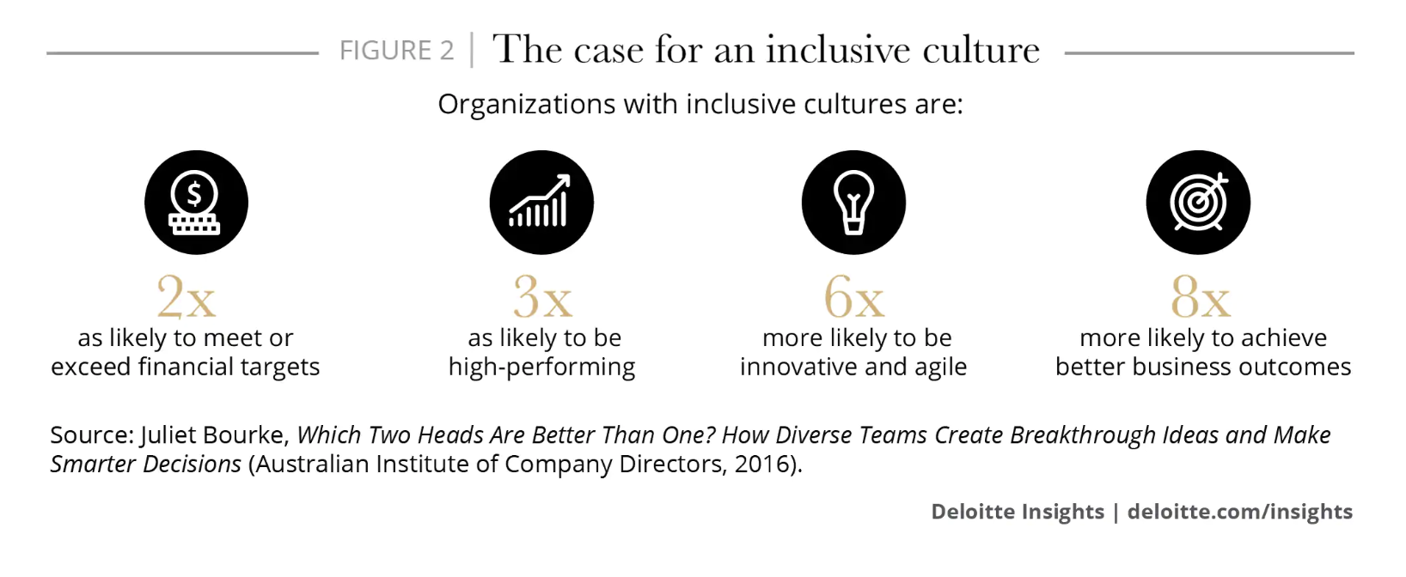
Why Inclusive Leaders Are Good for Organizations
Teams with inclusive leaders are 17 percent more likely to report that they are high performing, 20 percent more likely to say they make high-quality decisions, and 29 percent more likely to report behaving collaboratively.
Source: Harvard Business Review https://hbr.org/2019/03/why-inclusive-leaders-are-good-for-organizations-and-how-to-become-one
Notes:
53

Slide 54
Setting the Stage: Our Data and Why It Matters
128 companies were designated as World’s Most Ethical Companies in 2019. These companies represent 51 industries across 20 countries.
Honorees by Top Sectors
Honorees by HQ Location
Honorees by Ownership Structure
Honorees by Annual Revenues (USD)
Honorees by Workforce Size
Notes:
This question was not asked in EQ 2015 or earlier
54

Slide 55
Culture Breakdowns Are the Leading Cause of Misconduct
69 percent of settlements were identified as culture-related
The average cost of compliance failures caused by a poor culture is more than $40 million
Source: CEB Analysis
n = 209 settlements
Note: total does not equal 100% as multiple root causes were identified for each compliance failure
Notes:
55

Slide 56
Infrastructure to Support an Ethical Culture

Slide 57
How Leading Companies Measure Culture
What Type of Survey(s) Do You Use to Measure Ethical Culture within Your Organization? (Multiple select)
Among Ethisphere’s 2019 World’s Most Ethical Companies, the average number of methods used to measure whether their organization has an ethical culture was six. This indicates that measuring culture is a multidimensional and cross-functional effort.
We see a sharp increase in the use of physical site visits as a method to measure ethical culture (92 percent of Honorees in 2019 compared to 53 percent in 2018), illustrating the importance of face time.
Yet employee surveys remain the most common method, as reported by 99 percent of Honorees. The type and frequency of surveys conducted, however, varied across Honorees.
Source: 2019 World’s Most Ethical Companies Data Set. Ethisphere
Notes:
57

Slide 58
Communication Through Real-World Stories
Honorees that use examples of real-world ethical or compliance dilemmas or issues in E&C communications
The use of real-world dilemmas in E&C communications is ubiquitous among honorees
Honorees are split evenly between using internal and external examples
Source: 2019 World’s Most Ethical Companies Data Set. Ethisphere
Notes:
This question was not asked in EQ 2015 or earlier

Slide 59
Wide Variation of Policy Quality Among Risk Areas

Slide 60
Trust & Transparency, Led by the Board and C-Suite
32 percent of honorees communicate publicly on how many concerns were reported, the types of concerns reported, and the results of the corresponding investigations
84 percent of honorees provide executive/closed door sessions between program owners and the board, and 49 percent provide such opportunities to meet at least quarterly
91 percent of honorees are using things that have happened inside their organization in their ethics and compliance communications
Source: 2019 World’s Most Ethical Companies Data Set. Ethisphere

Slide 61
Leading from the Board and C-Suite, through the Company and Communities
54 percent have specifically charged a board committee with oversight of sustainability/social responsibility activities
Three-quarters of honorees are using multiple mechanisms to keep the board updated on the health of the organization’s culture
84 percent of honorees are integrating their community involvement strategy into their company’s overall strategic plan
Source: 2019 World’s Most Ethical Companies Data Set. Ethisphere

Slide 62
Increasing Directors’ Familiarity with Business Operations
Source: 2019 World’s Most Ethical Companies Data Set. Ethisphere

